Slide 1
Front End Engineering-I Project
Team Details:
ARYAN SEMWAL-2310991796
ARYAN YADAV-2310991797 ASHPREET SINGH ATWAL-2310991799
Faculty Coordinator:
Dr. RATTAN DEEP ANEJA
Chitkara University Institute of Engineering and Technology,
Chitkara University, Punjab

Slide 2
Table of Contents
Introduction
Problem Statement
Technical Details
Key Features
Project Highlights
Bonus Feature(optional)
Conclusion
References/Links used

Slide 3
Introduction
Title: “Memory Card Game:Test Your Memory”
Introduction:
The Memory Card Game is a timeless classic that challenges your memory and has been played for many years. It's a simple yet engaging game.
The main objective of the game is to flip two cards and find the matching pairs.
The project is a HTML , CSS AND JAVA based game that is a timeless classic that challanges your memory,focus,and attention.

Slide 4
Problem Statement
The problem that our project revolves around the decline in cognative skills of the brain as we age that leads to forgetfulness due to high stress in todays lifestyle.
A game website gains it audience only when it is eye pleasing attention grabbing and easy to use, since our project was to make a Memory Card Game our main objective was to make website minimalist and asthetically pleasing and relaxing to the mind at same time.

Slide 5
Technical Details
The Major technology used in the project were html, css and javascript.
HTML- It stands for Hypertext Markup Language, is the fundamental technology that powers the structure and content of web pages, serves as the backbone of the World Wide Web.
CSS- It is known as CSS, is a crucial technology in web development that complements HTML. CSS empowers web designers and developers to control the visual presentation and layout of web content.
VISUAL STUDIO CODE- The software used to write the code is vs code it has been extremely useful to write, edit and compile our codes together as a team.
JAVA SCRIPT- It is a scripting language used to create and controle dynamic website content.

Slide 6
Key Features
Navigation buttons given in the Home page to navigate between webpages through hyperlinking.
Animation used on the game to make it look more interesting.
Feedback page to get reviews from our players to improve our game more.
A page about the game history and link to similar games like ours.
Three different levels for the Game Easy, Medium and Hard.

Slide 7
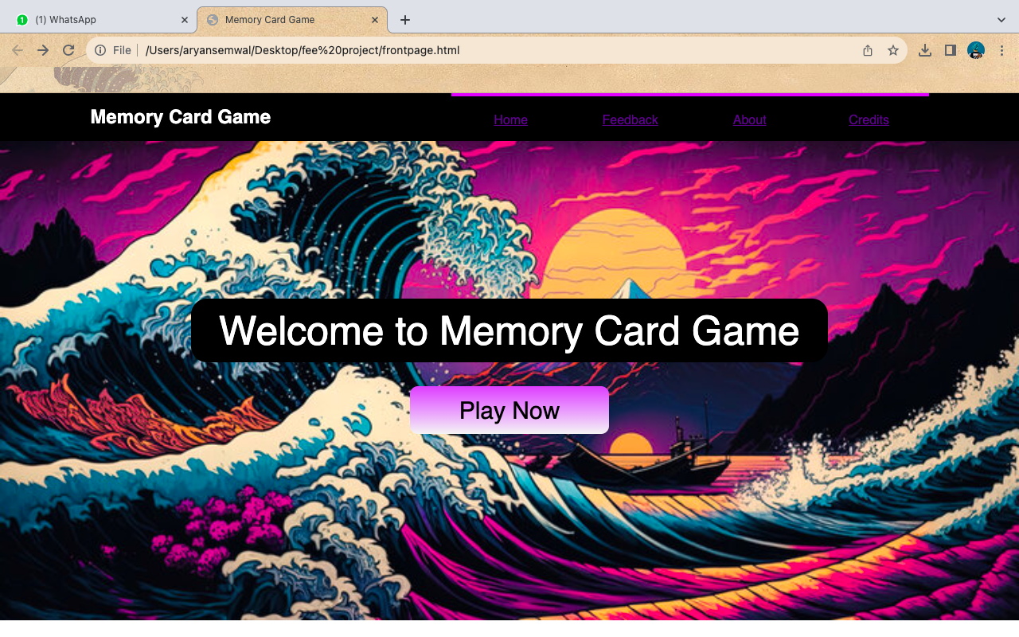
Project Highlights
HOME PAGE

Slide 8
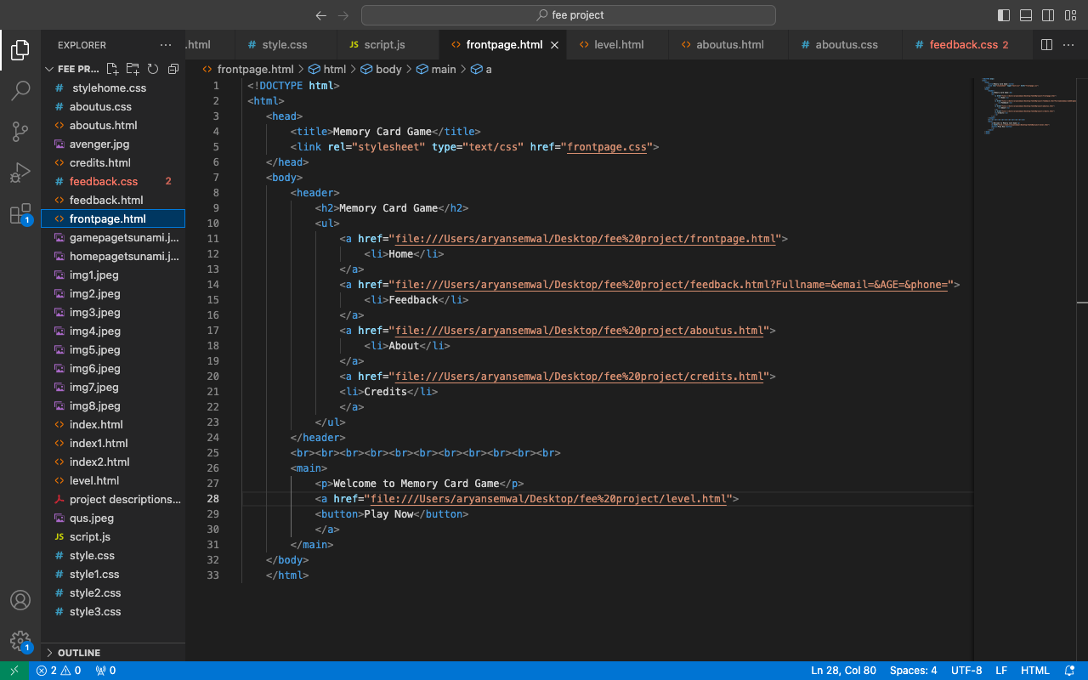
Project Highlights
HTML code for home page

Slide 9
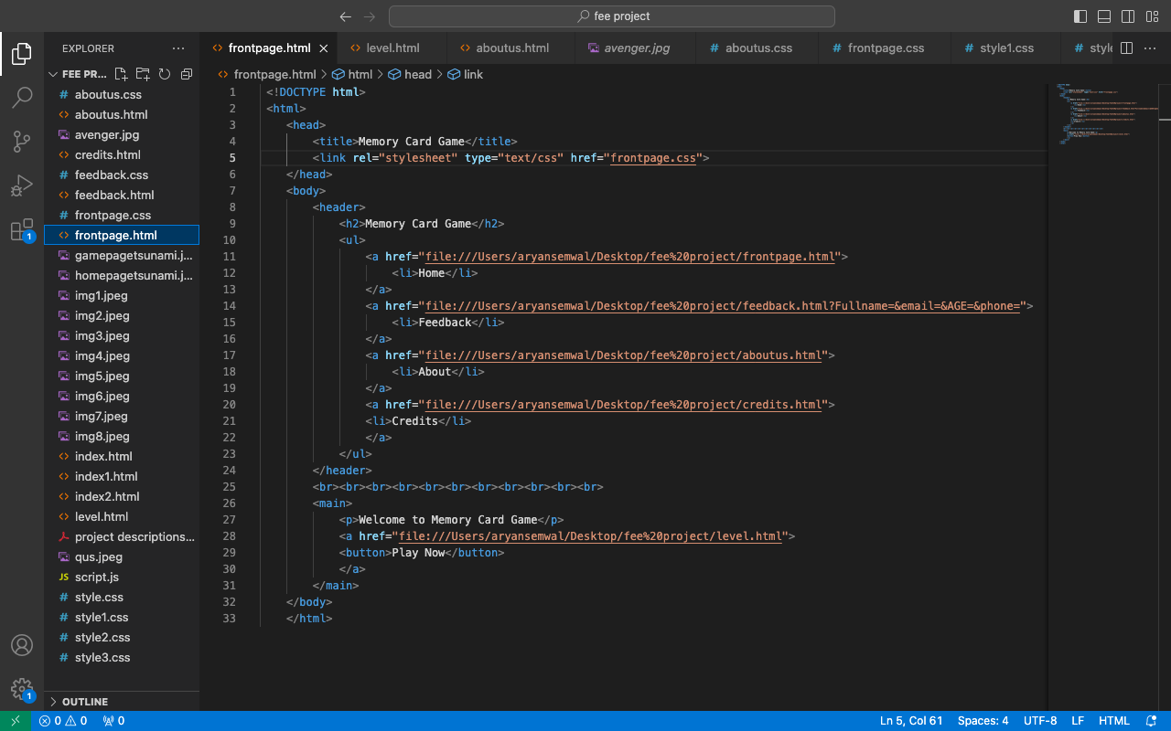
Project Highlights
CSS Code for Home Page

Slide 10
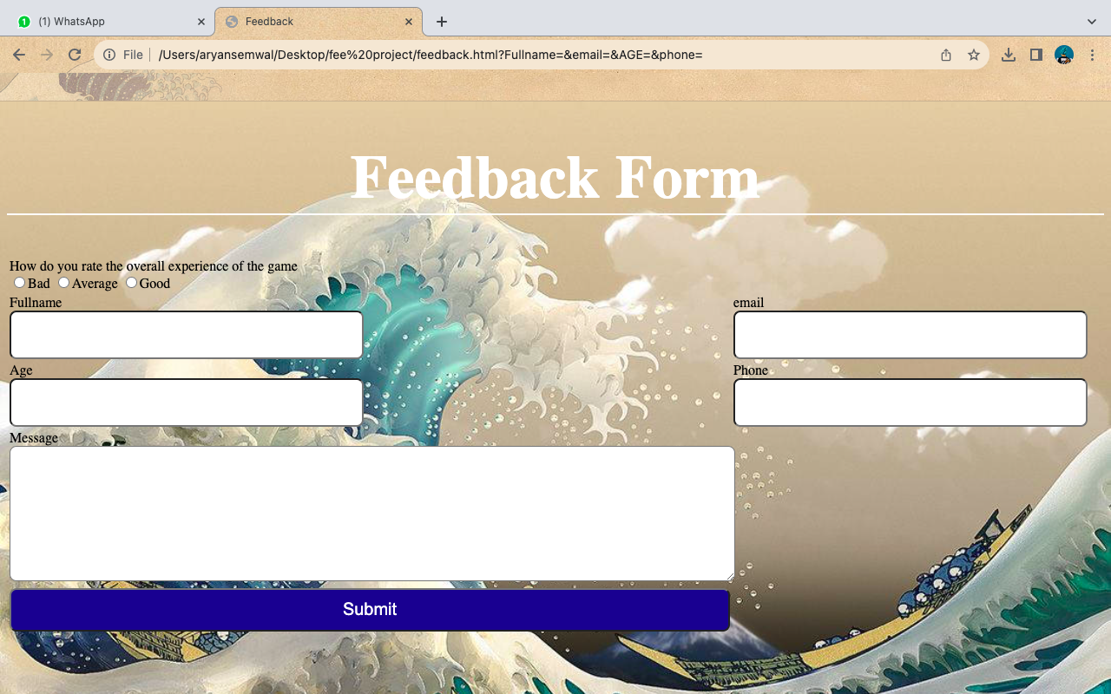
Project Highlights
Feedback

Slide 11
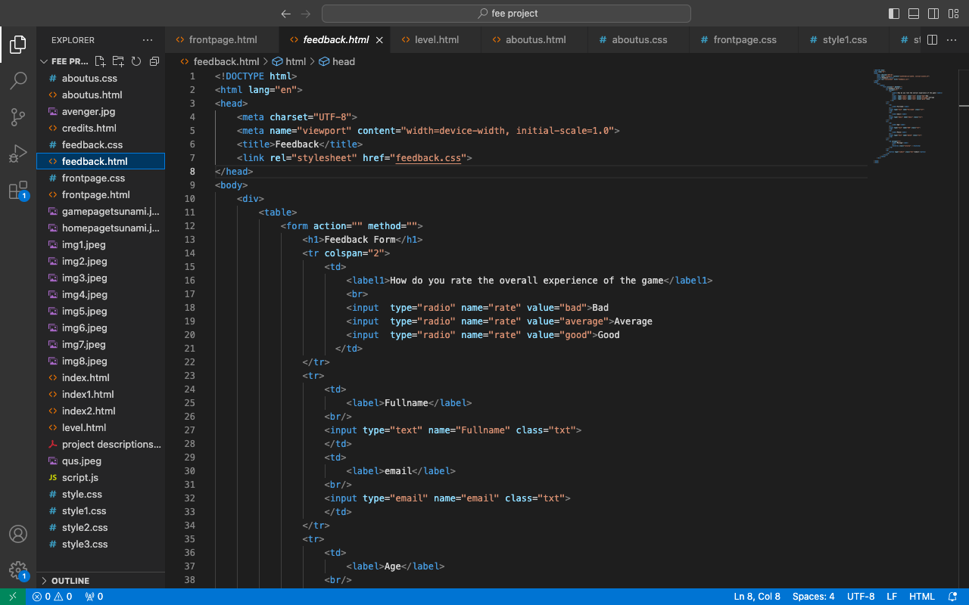
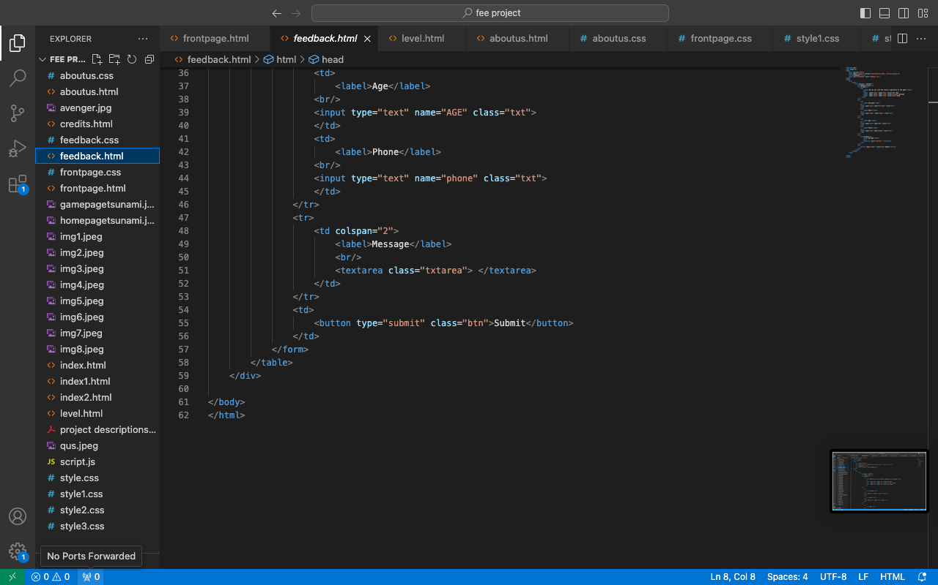
Project Highlights
FeedBack

Slide 12
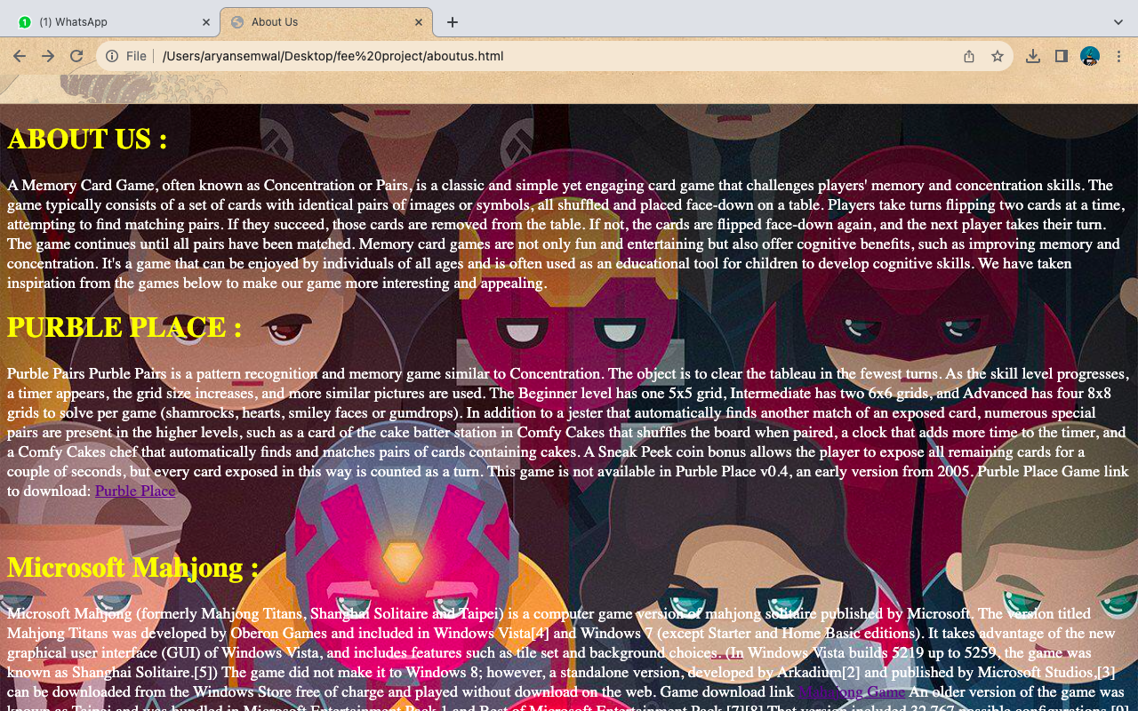
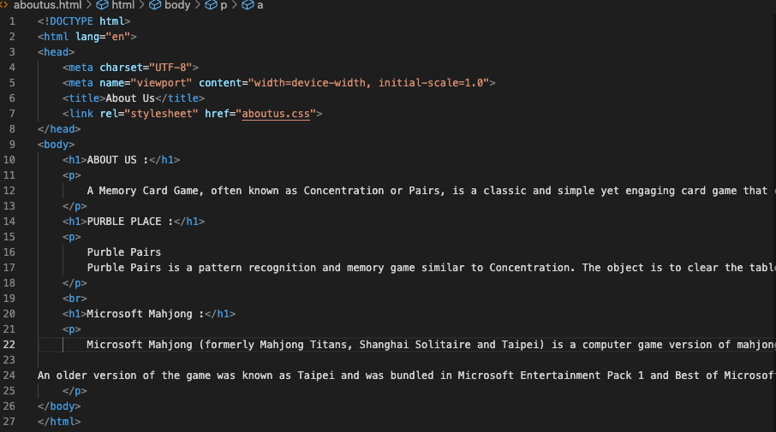
Project Highlights
About Page and Code

Slide 13
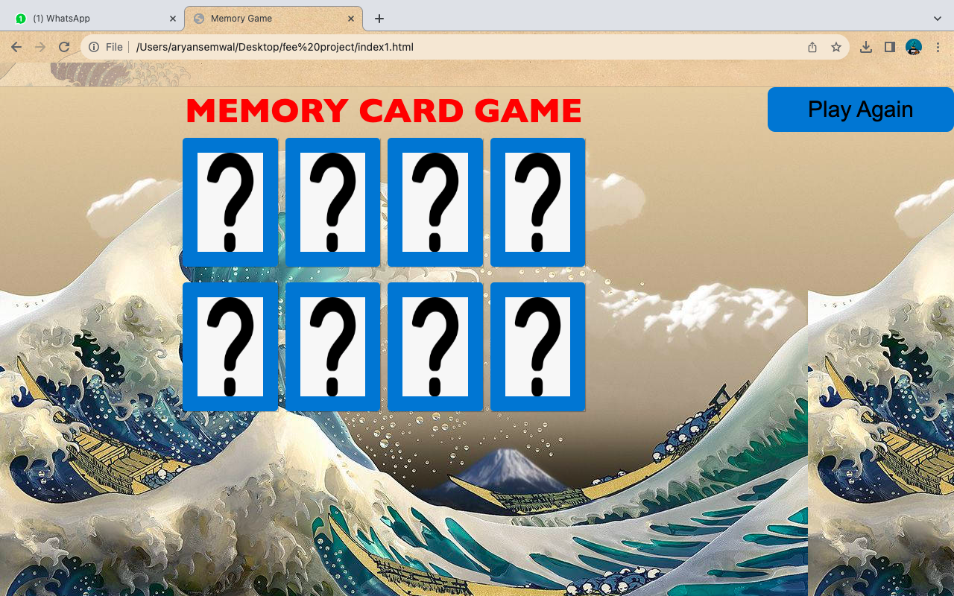
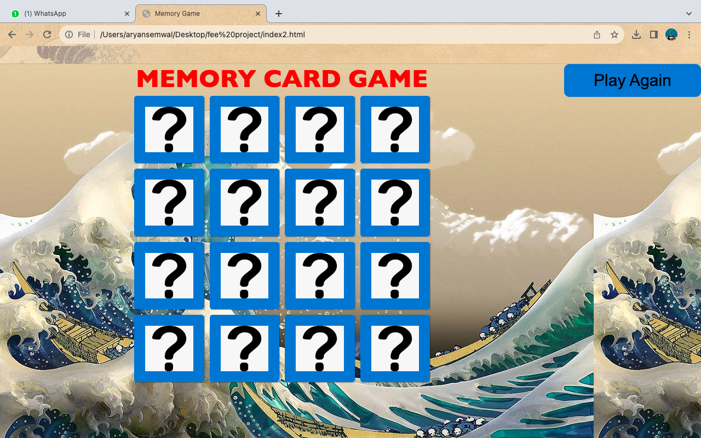
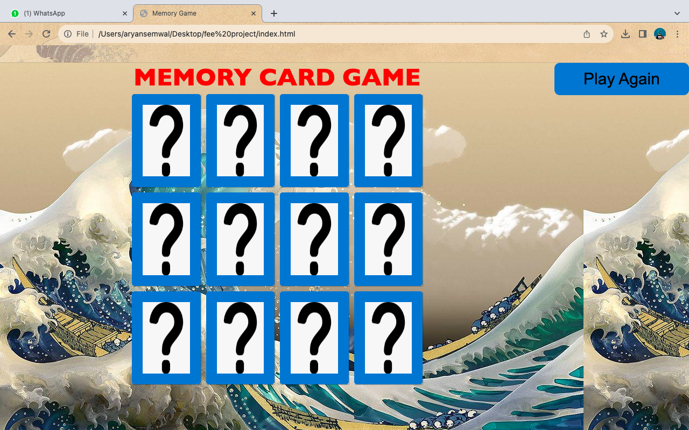
Project Highlights
Game Page

Slide 14
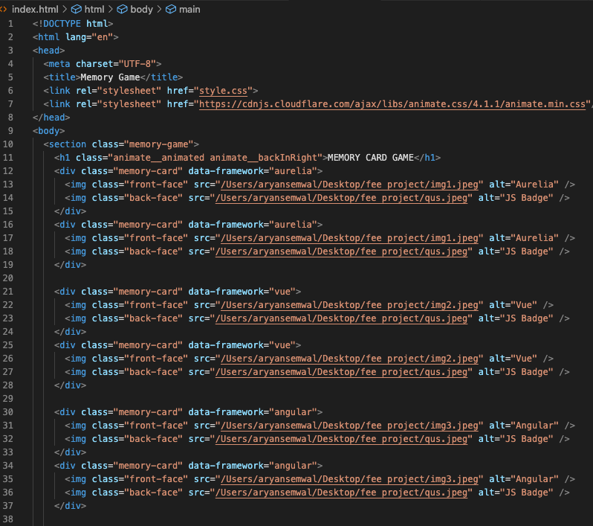
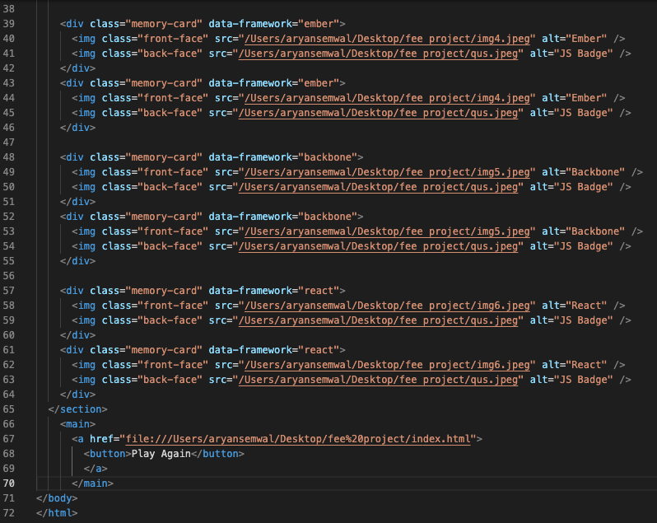
Project Highlights
Game Code

Slide 15
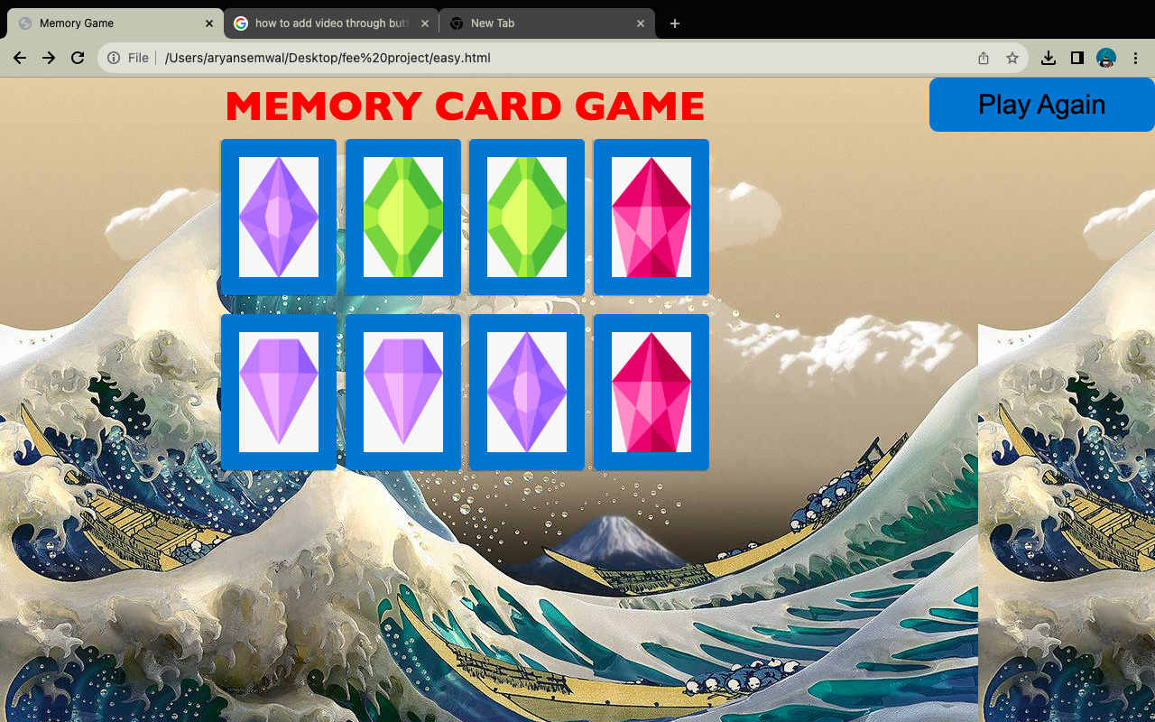
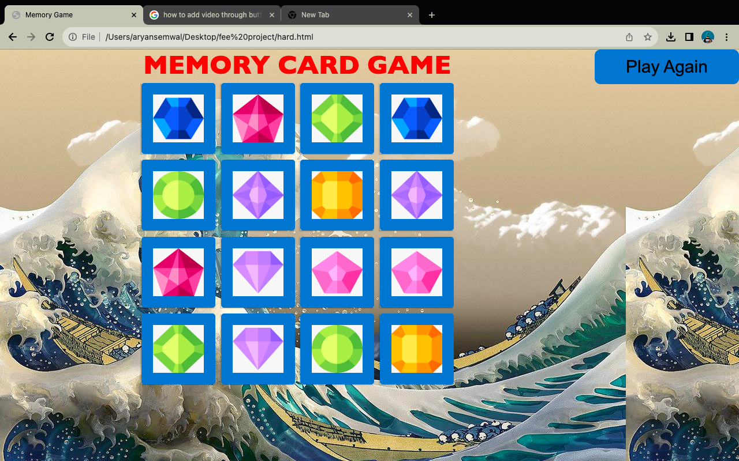
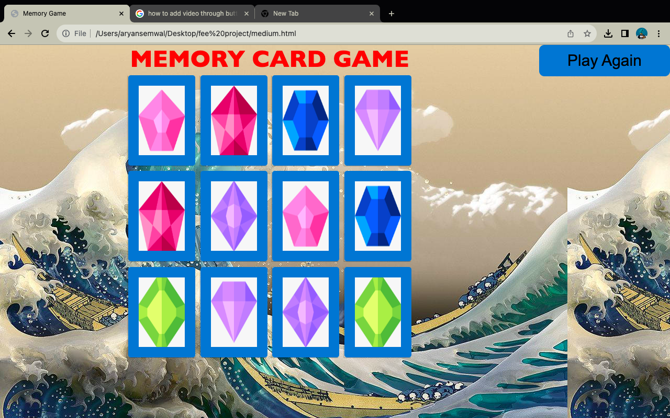

Slide 16
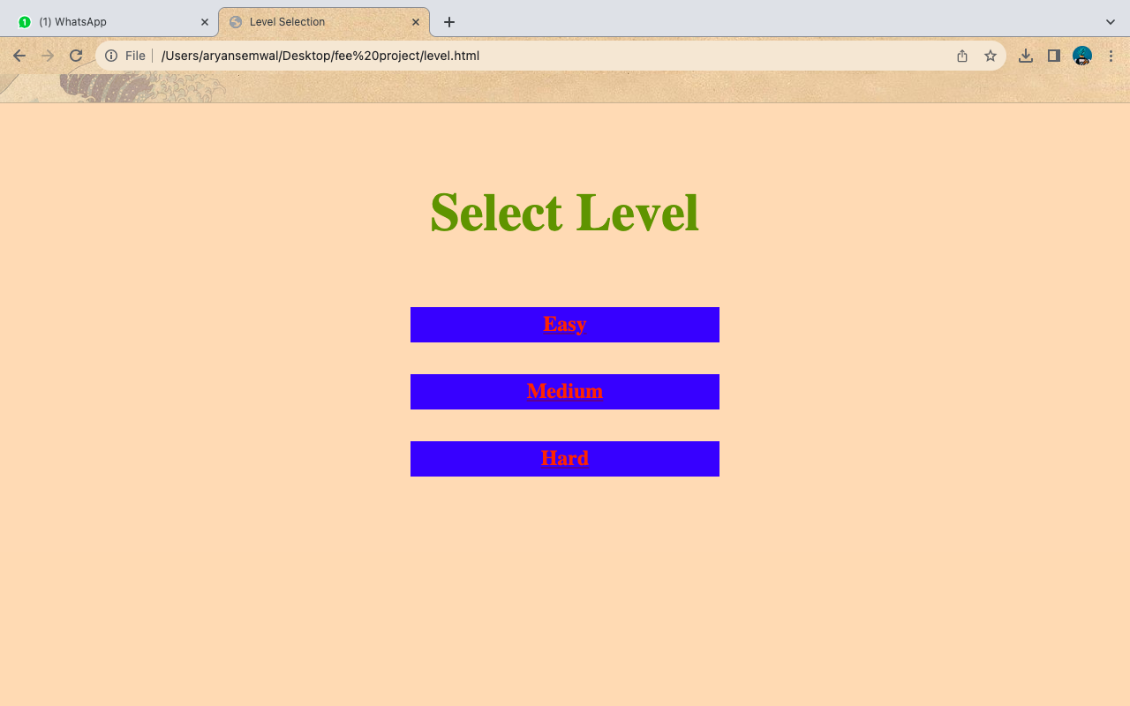
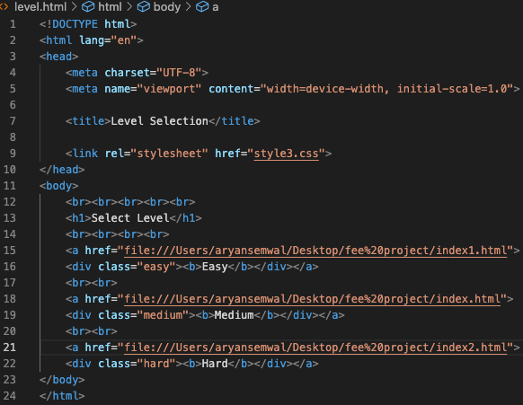
Bonus Feature(optional)
Difficulty Level For the Game and its Code

Slide 17
Conclusion
Memory card games are more than just a pastime; they are a valuable tool for memory enhancement, cognitive development, and entertainment. Their historical significance, benefits, adaptability, and widespread popularity make them a timeless and accessible option for individuals looking to sharpen their memory skills while having fun. Whether in traditional card form or as digital applications, memory card games continue to engage and educate people across the globe. The HTML and CSS-based product Memory Card Game successfully met project objectives, delivering a user-friendly, and visually appealing solution. The inclusion of bonus features further enhanced usability and engagement, positioning Memory Card Game for offline success.
The major take away from the project is using different tags, interlinking, hyperlinking different webpages learning how to compile different codes togethere as a team.

Slide 18
References/Links used
Youtube
Goggle Chrome
W3School - https://www.w3schools.com/

Slide 19


